Slide 1


Introduction to Git/GitHub Mini-Workshop
The Poretsky Lab
24 July 2025

Slide 2

What is Git/GitHub?
Git is a free, open-source version control system designed to track all changes to a designated set of files(referred to as a “repository” or “repo”) on your local machine.
GitHub is a widely used website for hosting and sharing Git repositories remotely.

Slide 3

Who cares about version control?
We do!
Version control:
Allows for the collaboration of multiple parties on a single written document or code.
Maintains a detailed log of document changes without the need for multiple versions of a file (e.g., v1, v2, final, etc.).
Allows easy rollback to a previous file version if new writing introduces an error or problem
Allows for a deeper understanding of writing or code, such as:
How a file has changed over time
Who has contributed what to the file, which in turn tells you who can help you with a particular aspect of the document

Slide 4
Workshop Overview
Common Git/GitHub Terminology
Git vs. GitHub
Cloning vs. Forking vs. Branching
Material Review
Practical Exercise
Closing

Slide 5
Common Git/GitHub Terminology
Repository (B) – directory of subdirectory or files being managed by the version control system
Branch (B) – Allows for collaborators to contribute to the project without pushing edits to the main branch
Fork (GH)* – Copying a snapshot of a remote repository to your remote GitHub server (R -> R)
Clone (B) – Copying a snapshot of a remote repository to your local machine (R -> L)
Add (G) – Function to inform Git which file changes it should add to the staging area (L -> L)
Commit (G) – Function to inform Git to take a snapshot of changes (also a ”commit”) in the staging area to prepare for push (L -> L)
Push (G) – Function to contribute local changes to the remote repository (L -> R)
Fetch (GH) – Function to retrieve changes from a remote repository to a local remote tracking branch (R -> R)
Merge (B) – Function to integrate changes from remote repository to local machine (L -> R) or multiple repository branches (R -> R)
Pull (G) – Combines the functionality of git fetch and git merge
Pull Request (GH)* – Request to integrate changes from a forked repository to the original (R -> R)

Slide 6
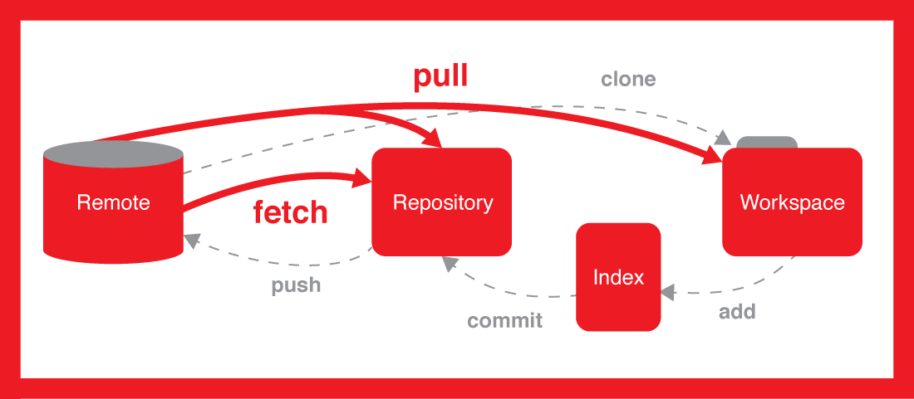

Common Git/GitHub Terminology
Pull
Merge

Slide 7
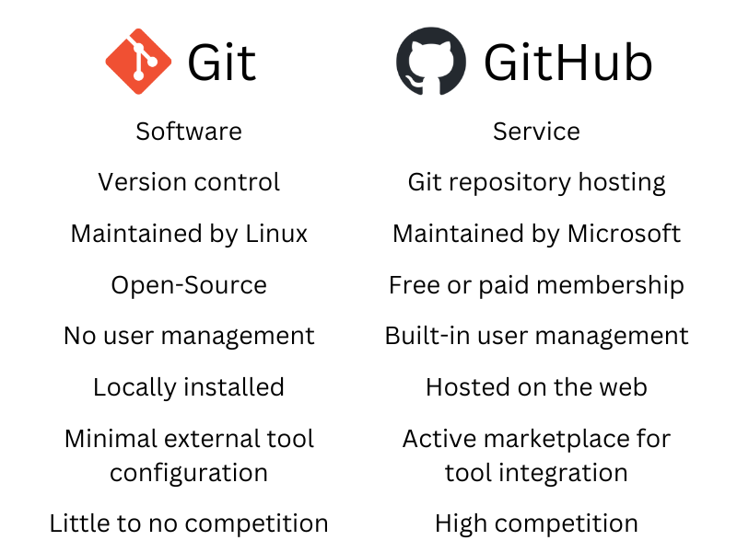
Git vs. GitHub
Though often used interchangeably, Git and GitHub are two distinct services with very different purposes
Remote = GitHub
Local = Git

Slide 8
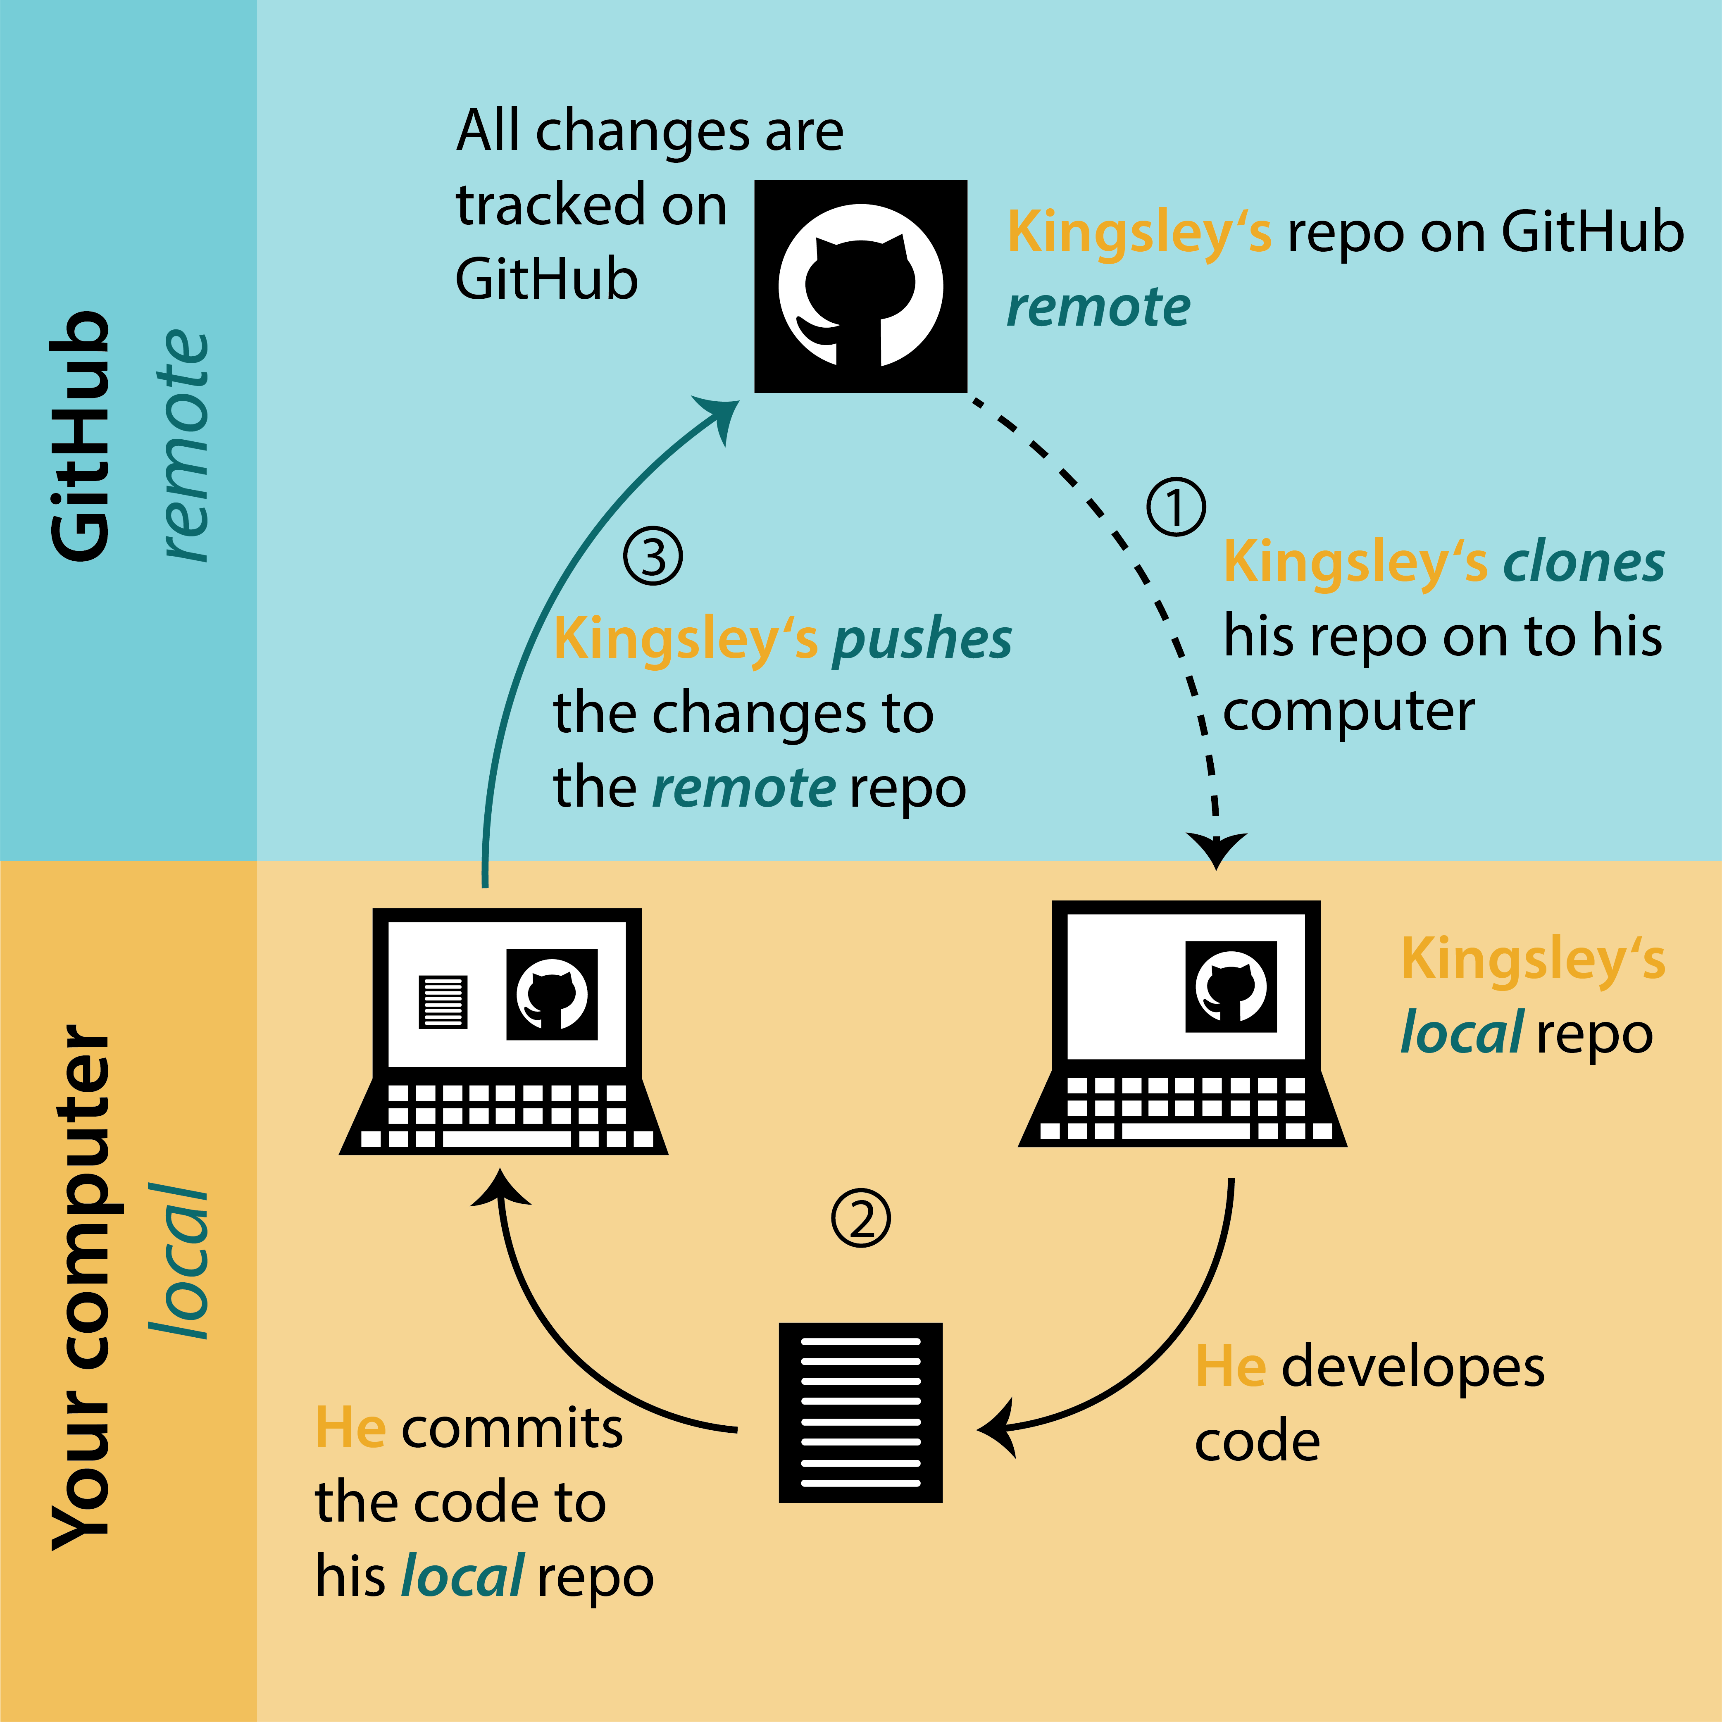
Git vs. GitHub

Slide 9
Cloning vs. Forking vs. Branching
Branching (least applicable): used when a collaborator (i.e., personnel with write/push permissions to a repository) would like to make changes to a source code/repository without hosting these changes on the main branch.
Ex. Using a beta (or test) branch before merging changes to the main (or production) branch.
Forking (more applicable): Used when a non-collaborator would like to make contributions to a source code/repository
Must submit a pull request to have commits merged to the main branch by the repository owner
Ex. Contributing to a team member’s project – allows for approval of changes before merging
Cloning (most applicable): Used to copy a remote repository to a local machine (or remote HPC system)
Ex. Cloning a remote repository to store and manage R and Python scripts for an ongoing manuscript

Slide 10
Pop Quiz: Prompt
Members of the Poretsky Lab are interested in using high-throughput sequencing to characterize the skin microbiome of Necturus maculosus (mudpuppies) collected from the Sangamon River and Lake Michigan. With multiple collaborators expected to contribute to the massive data analysis efforts, the project lead (Dolores) suggested maintaining a GitHub repository to host, share, and manage everyone’s efforts. With everything already stored on GitHub, Dolores also notes that preparing the work to become available for publication will be much easier when the time comes.

Slide 11
Pop Quiz: Question 1
As the project lead, Dolores would like to create a repository on the Poretsky Lab GitHub Page titled “Muddpuppy_Microbiome_Project”.
Dolores should use:
Git
GitHub

Slide 12

Pop Quiz: Question 1
As the project lead, Dolores would like to create a repository on the Poretsky Lab GitHub Page titled “Muddpuppy_Microbiome_Project”.
Dolores should use:
Git
GitHub

Slide 13
Pop Quiz: Question 2
Dolores adds Michael, Christopher, and Erik as collaborators to the repository, each with their own data analysis project. While everyone has permissions to push to the main branch, they choose to work on a secondary branch until the project scripts have been reviewed and finalized.
They should:
Clone the main branch
Create a secondary branch
Fork the main branch

Slide 14
Pop Quiz: Question 2
Dolores adds Michael, Christopher, and Erik as collaborators to the repository, each with their own data analysis project. While everyone has permissions to push to the main branch, they choose to work on a secondary branch until the project scripts have been reviewed and finalized.
They should:
Clone the main branch
Create a secondary branch
Fork the main branch

Slide 15
Pop Quiz: Question 3
Dolores recruits an undergraduate student interested in learning how to analyze genomic data with R. Dolores assigns the student to develop stacked bar graphs for the microbiome of the Lake Michigan Mudpuppies, using her code from the Sangamon River samples as a template. While the student’s work will be used for the publication, Dolores would like to approve all their commits before merging their work with the secondary branch.
The student should:
Clone the secondary branch
Fork the main branch
Fork the secondary branch

Slide 16
Pop Quiz: Question 3
Dolores recruits an undergraduate student interested in learning how to analyze genomic data with R. Dolores assigns the student to develop stacked bar graphs for the microbiome of the Lake Michigan Mudpuppies, using her code from the Sangamon River samples as a template. While the student’s work will be used for the publication, Dolores would like to approve all their commits before merging their work with the secondary branch.
The student should:
Clone the secondary branch
Fork the main branch
Fork the secondary branch

Slide 17
Pop Quiz: Question 5A
Christopher is building a random forest model to define the top taxa distinguishing the skin microbiome of mudpuppies between the two sampling locations. The FASTQ files are numerous and quite large, so he opts to perform his analysis on an HPC system, but would like to update the rest of the team while he refines his script. First, Christopher would like to copy the remote project directory to his HPC home directory.
Christopher should use:
GitHub
Git

Slide 18
Pop Quiz: Question 5A
Christopher is building a random forest model to define the top taxa distinguishing the skin microbiome of mudpuppies between the two sampling locations. The FASTQ files are numerous and quite large, so he opts to perform his analysis on an HPC system but would like to update the rest of the team while he refines his script. First, Christopher would like to copy the remote project directory to his HPC home directory.
Christopher should use:
GitHub
Git

Slide 19
Pop Quiz: Question 5B
Christopher is building a random forest model to define the top taxa distinguishing the skin microbiome of mudpuppies between the two sampling locations. The FASTQ files are numerous and quite large, so he opts to perform his analysis on an HPC system, but would like to update the rest of the team while he refines his script. First, Christopher would like to copy the remote project directory to his HPC home directory.
Christopher should:
Clone the secondary branch
Clone the main branch
Fork the secondary branch

Slide 20
Pop Quiz: Question 5B
Christopher is building a random forest model to define the top taxa distinguishing the skin microbiome of mudpuppies between the two sampling locations. The FASTQ files are numerous and quite large, so he opts to perform his analysis on an HPC system, but would like to update the rest of the team while he refines his script. First, Christopher would like to copy the remote project directory to his HPC home directory.
Christopher should:
Clone the secondary branch
Clone the main branch
Fork the secondary branch

Slide 21
Pop Quiz: Question 6
The undergraduate student has finished writing their code and would like to share their results with Dolores to add to the secondary branch.
The student should:
Fetch from the main branch
Submit a pull request
Merge everyone’s work to the main branch

Slide 22
Pop Quiz: Question 6
The undergraduate student has finished writing their code and would like to share their results with Dolores to add to the secondary branch.
The student should:
Fetch from the main branch
Submit a pull request
Merge everyone’s work to the main branch

Slide 23
Practical Exercise: Learning Objectives
Learn how to:
Fork a remote directory to your remote GitHub server
Create a new folder within a remote repository
Clone a remote repository to your local machine
Add, commit, and push changes from local machine to remote repository
Submit a pull request from forked repo back to main repo

Slide 24

Part 1: Forking a repository
Navigate to the Practice_Repo within the Poretsky Lab GitHub.
Click the “Fork” button to fork the directory. Once named, the directory will be accessible within your personal remote GitHub Server.

Slide 25
Part 2: Creating a folder within a remote repository
Access the “Team_Poretsky” directory within the forked repository, and select the “create new file” option within the “add file” dropdown menu
For the file name, type “your name”/Who_am_I.txt and hit “commit changes” when finished.
NOTE: the backslash after your name is used to create new folders within GitHub. However, a file MUST be created to create a new folder.

Slide 26
Part 3: Cloning a repository to your local machine
Cloning a repository can be completed either through Git via the command line or by using the GitHub Desktop app.
To push changes from your terminal, you will need to create an SSH Key. From your terminal, type “ssh-keygen -t ed25519 -C your_email@example.com using your account email address, and hit enter to save your key (you will need to hit enter a few times).
Type “pbcopy < ~/.ssh/id_ed25519.pub” to save your key. From the repository home page, select “add a new key “ from the SSH section within the ”<> Code” dropdown menu. Paste your key where prompted and save.
Return back to the repository home page, and copy the ssh link under the ”<> Code” dropdown menu.

Slide 27
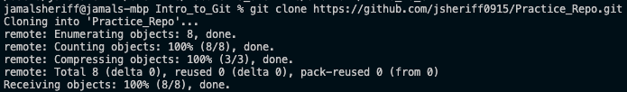

Part 3: Cloning a repository to your local machine
Within the terminal, navigate to the directory to where you would like to clone the git repository.
Type ”git clone instert_https_link”
To ensure proper cloning, navigate to within the cloned repo and type “ls –a” to see all files within the directory. If successful, a “.git” file should be visible.

Slide 28

Part 3: Cloning a repository to your local machine
Within your own directory, you will need to complete two tasks:
Add an image of your favorite animal or pet to your folder.
Edit the Who_am_I.txt file and add your name, or any other way you’d like to identify yourself.
NOTE: From the terminal this can be done with either the “nano” or ”vi” functions. Within nane, type “nano Who_am_I.txt” to open the file. After typing your message, hit CRTL+X, Y, and then ENTER to save your file. Type “cat Who_am_I.txt” to view the contents of the file.
When complete, your directory should look similar to this:

Slide 29
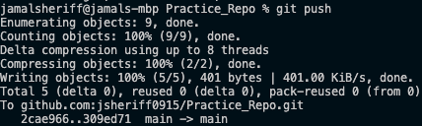
Part 4: Add, commit, and push changes to the remote repository
When you are ready to push your changes back to the remote repository, type “git add . “ and then “git commit –m “Insert update message”(use quotes around your update message)” to add and commit your changes to the staging area.
Type ”git push” to push your commits back to the remote repository.

Slide 30
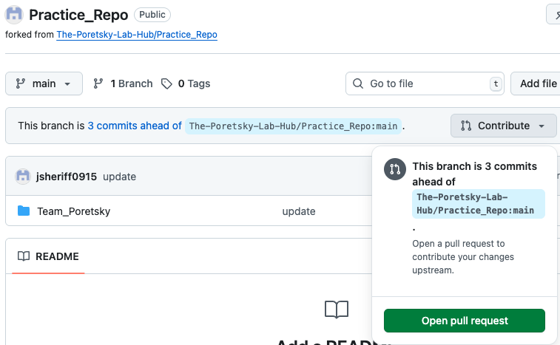
Part 5: Submit a pull request
Return back to the updated remote repository within your web browser. To send a pull request, click the “Open pull request” option under the “Contribute” dropdown menu. Enter a title for the request and hit “create pull request” near the bottom.

Slide 31
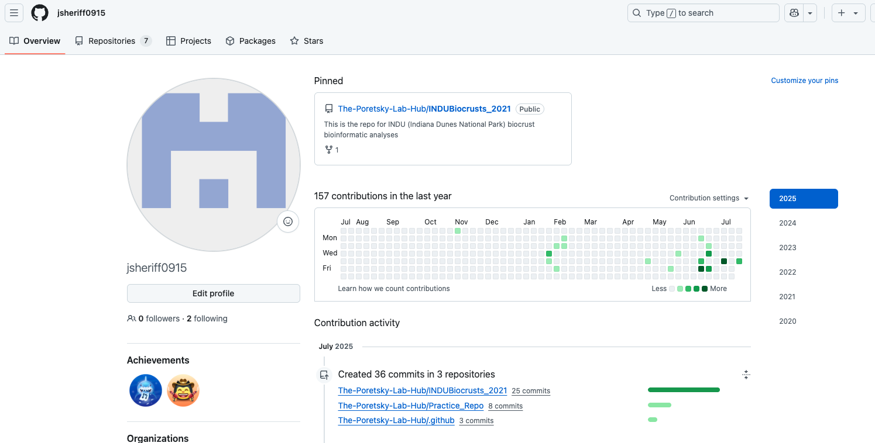
Congrats – you’ve completed your practical!
Benefits of continuing your GitHub usage:
Making your code publicly available is an excellent reproducible research practice!
Using the Poretsky Lab Hub as a central area for your code and scripts can be an accessible resource for future lab members.
Your GitHub profile tracks and presents all your activities on GitHub – clear evidence to future employers that you are Git/GitHub savvy!

Slide 32
Thank you!
Feel free to reach out with any questions you have!

